Slide 1

CE101 Engineering Drawing Lec3: Orthographic Projections
Indian Institute of Technology Guwahati
Notes:
Today we will discuss about the Modeling and

Slide 2
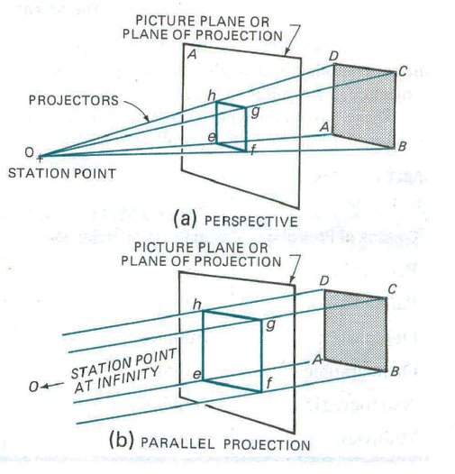
In engineering drawing, the word ‘projection’ means
an image or the act of obtaining the image of an object.
Technical people often refer to the image as a view.
Projection System
Observer or stationary point
Object
Projectors
Plane of projections (POP)

Slide 3
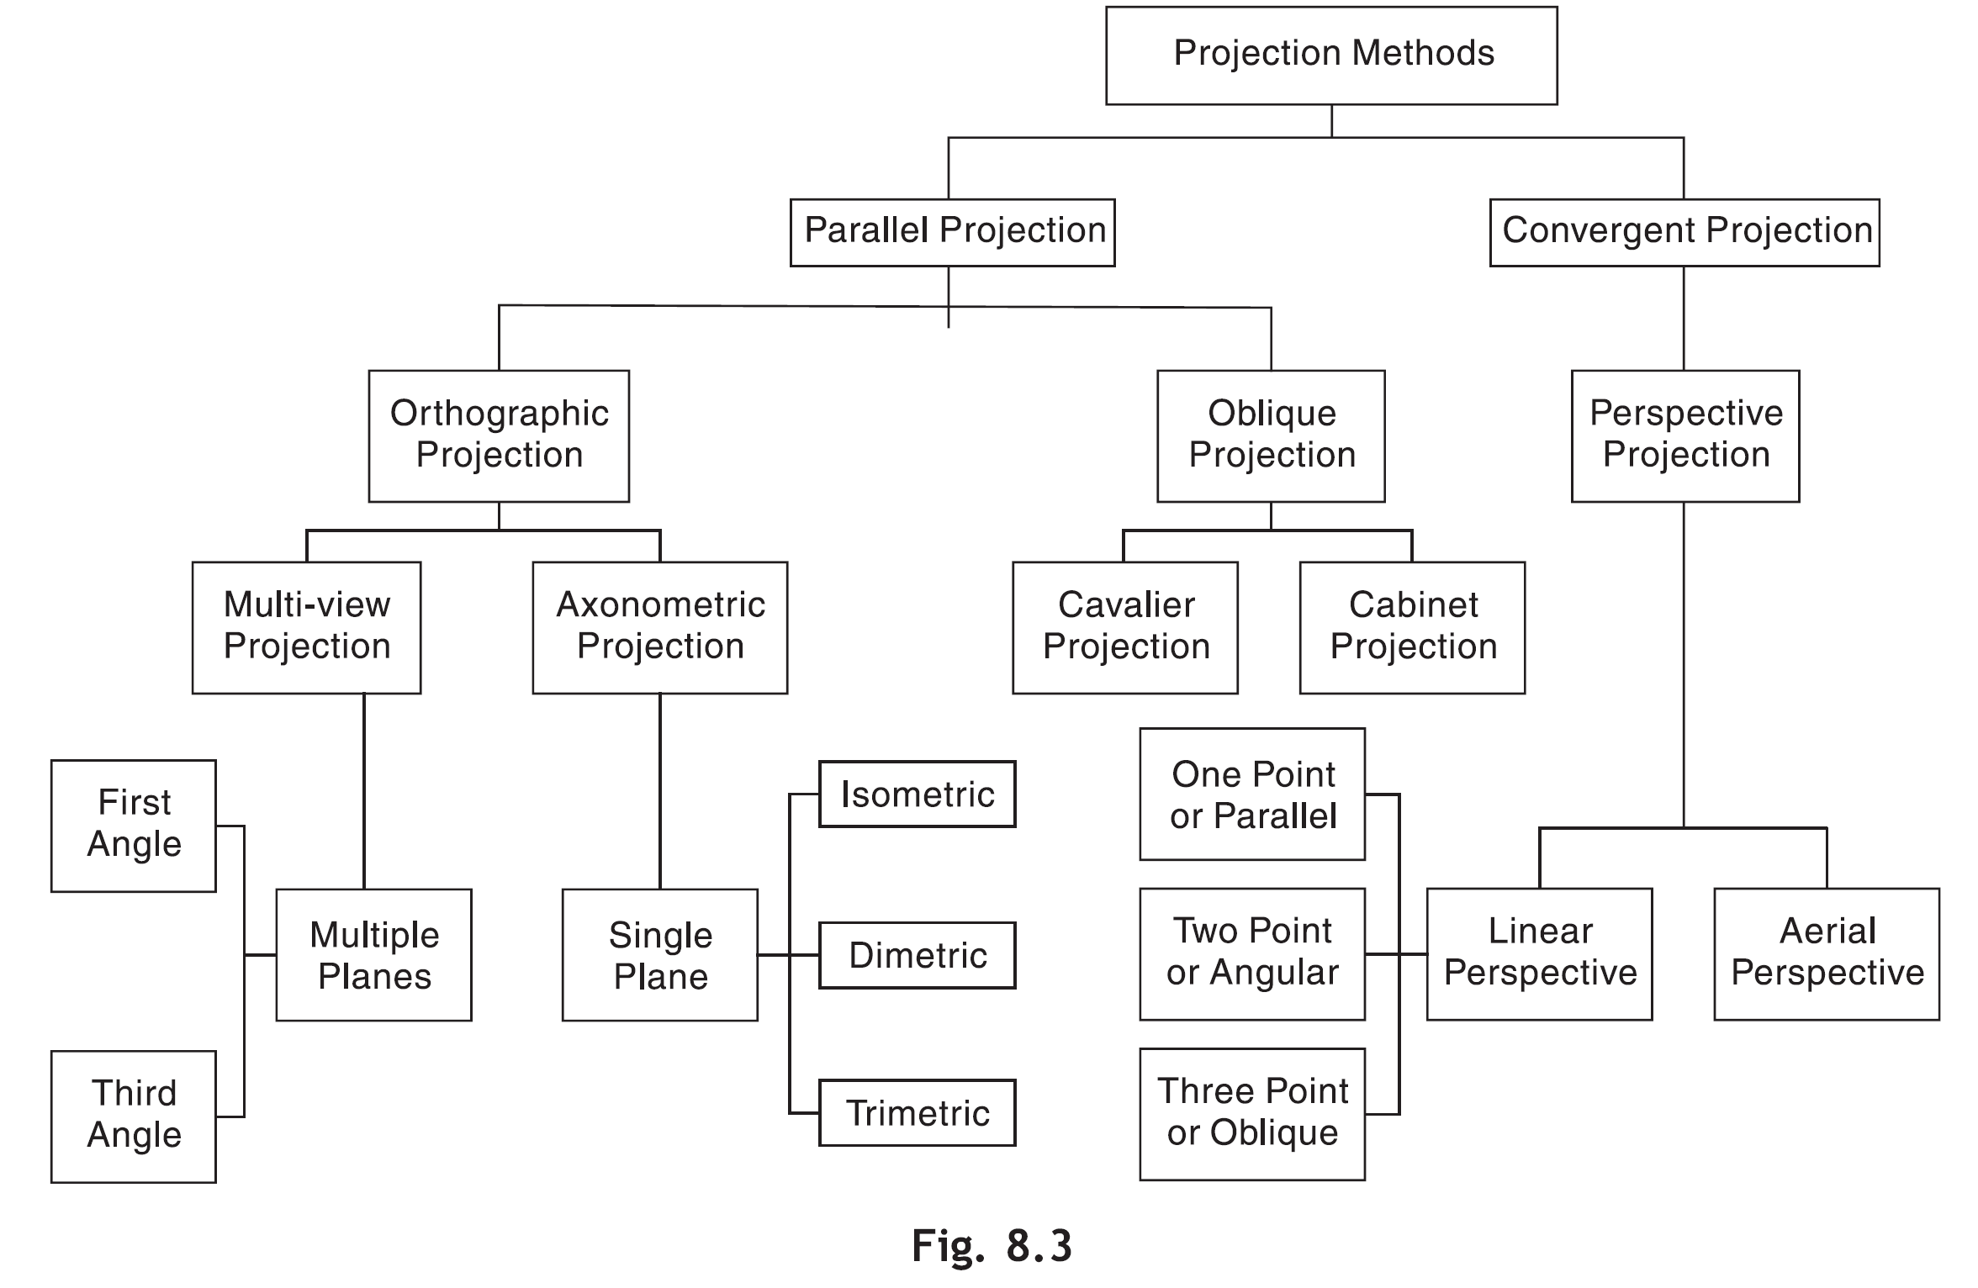
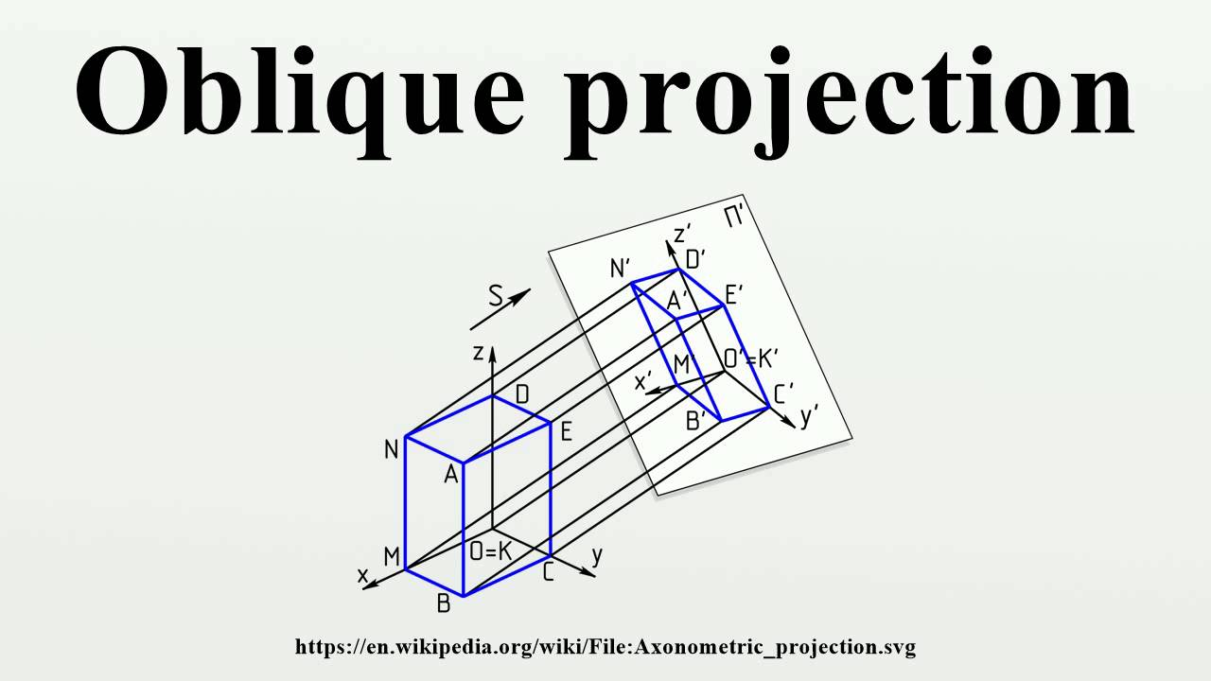
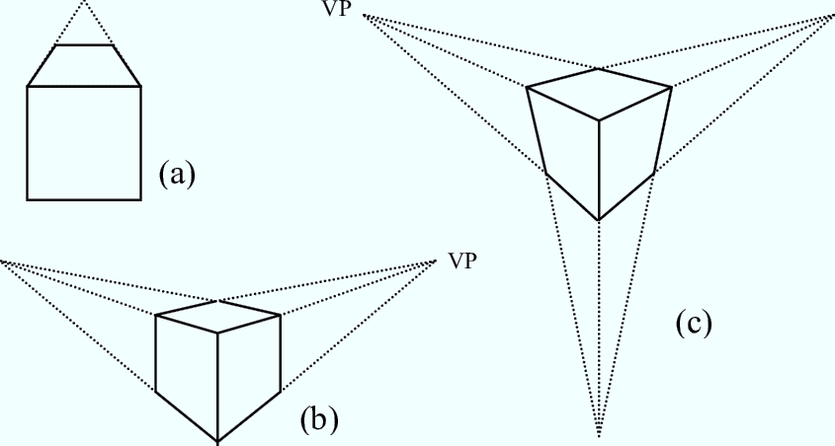

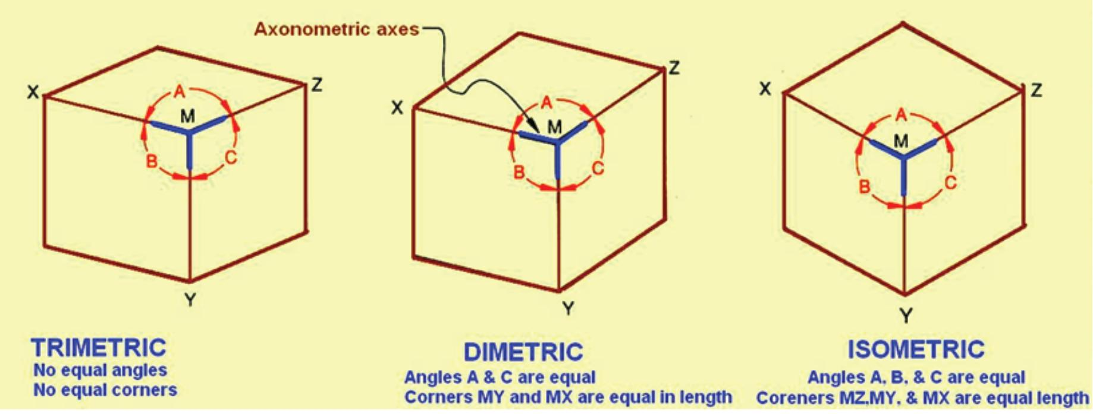
PROJECTION METHOD
Depending on the relationship between the projectors and POP, and the number of POPs used for the projections, the projection methods are classified as follows

Slide 4
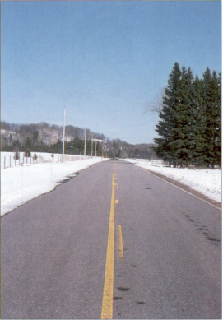
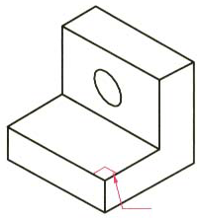
View comparison
Type
Advantage
Disadvantage
Multi-view drawing
Accurately presents object’s details, i.e.
size and shape.
Require training
to visualization.
Pictorial drawing
Easy to visualize.
Shape and angle distortion
Circular hole becomes ellipse
Right angle becomes obtuse angle.
Perspective drawing
Object looks more like what our eyes
perceive.
Difficult to create
Size and shape distortion
Distorted
width

Slide 5
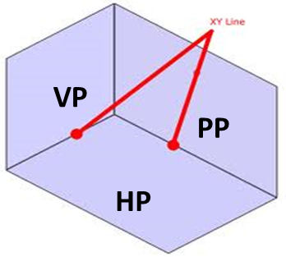
Orthographic Projections
Orthographic Projections is a technical drawing in which different views of an object are projected on different reference planes, while observing perpendicular to the respective reference plane.
Different Reference planes (or Principal planes)
Horizontal Plane (HP)
Horizontal reference plane (HRP)
Vertical Plane (VP)
Frontal reference plane (FRP)
Side or Profile Plane (PP)
Profile reference plane (PRP)
Different views are;
Front View (FV) – Projected on VP
Top View (TV) – Projected on HP
Side View (SV) – Projected on PP
FV
SV
TV

Slide 6
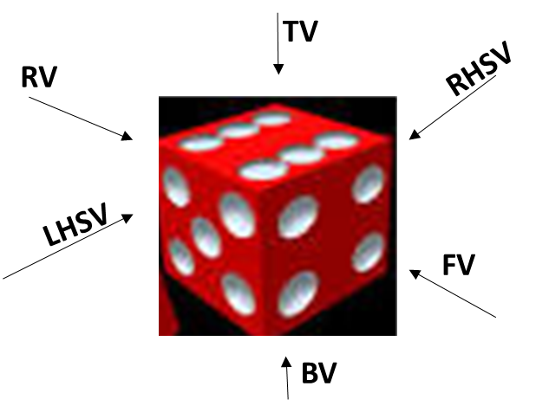
Front View When the observer looks at the object from the front, the view obtained is called the front view (FV) or Elevation. FV is seen on the VP.
Rear View When the observer looks to the object from back, the view obtained is called rear view (RV) or back view or rear elevation.
Top View When the observer looks at the object from above, the view obtained is called top view (TV) or plan. TV is seen on the HP.
Bottom View When the observer looks to the object from below, the view obtained is called bottom view (BV) or bottom plan.
Side Views When the observer looks at the object from side, i.e., from his left-hand side or righthand side, the view obtained is called side view (SV). SV is seen on the PP.
Left-Hand Side View When the observer views the object from his left-hand side, the view obtained is called left-hand side view (LHSV).
Right Hand Side View When the observer views the object from his right-hand side, the view obtained is called as right-hand side view (RHSV).
The FV, TV and either LHSV or RHSV are usually drawn in orthographic projection. The other views are added if they are extremely essential.

Slide 7
PLANES
PRINCIPAL PLANES
HP AND VP
AUXILIARY PLANES
Auxiliary Vertical Plane
(A.V.P.)
Auxiliary Inclined Plane
(A.I.P.)
Profile Plane
( P.P.)

A.V.P.
A.I.P.
⊥ to Hp & ∠ to Vp
⊥ to Vp
&
∠ to Hp


Slide 8
Multi-view orthographic projections
In this type of projection, we imagine the object being drawn in the center of a transparent box.
The different views of the object are projected onto the sides of this box.

Slide 9
Multi-view orthographic projections
The projection box and its six views are spread in such a way as to place all the views on the same plane.
The other views pivot around the front view.
TOP VIEW
REAR VIEW
LEFT SIDE VIEW
FRONT VIEW
RIGHT SIDE VIEW
BOTTOM VIEW

Slide 10
Multi-view orthographic projections
Among the six possible views, we will choose to portray those necessary to the description of the shape of the object.
Three views are usually enough to portray an object. Many simple objects may only require one or two views.
TOP VIEW
REAR VIEW
LEFT SIDE VIEW
FRONT VIEW
RIGHT SIDE VIEW
BOTTOM VIEW

Slide 11
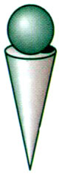
Projection systems
1. First angle system
- European countries - ISO standard
First
quadrant
2. Third angle system
- Canada, USA, Japan, Thailand
Transparent
planes
Opaque
planes
Third
quadrant

Slide 12
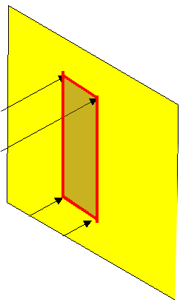
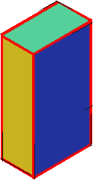
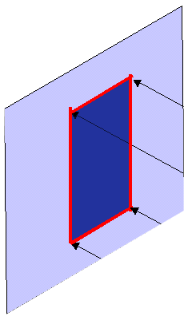
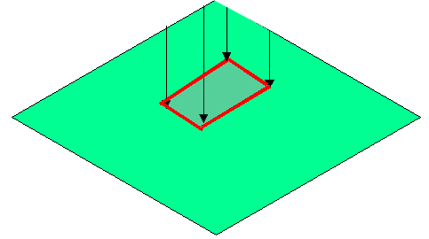
FIRST ANGLE
PROJECTION
FOR T.V.
IN THIS METHOD,
THE OBJECT IS ASSUMED TO BE
SITUATED IN FIRST QUADRANT
MEANS
ABOVE HP & INFRONT OF VP.
V.P.
P.P.
F.V.
S.V.
OBJECT IS INBETWEEN
OBSERVER & PLANE.
OBJECT
VP
PP
FV
LSV
X
Y
FOR S.V.
FOR F.V.
TV
HP
ACTUAL PATTERN OF
PLANES & VIEWS
IN
FIRST ANGLE METHOD
OF PROJECTIONS

Slide 13
THIRD ANGLE
PROJECTION
FOR T.V.
IN THIS METHOD,
THE OBJECT IS ASSUMED TO BE
SITUATED IN THIRD QUADRANT
( BELOW HP & BEHIND OF VP. )
PLANES BEING TRANSPERENT
AND INBETWEEN
OBSERVER & OBJECT.
P.P.
V.P.
OBJECT
TV
X
Y
S.V.
F.V.
LSV
FV
ACTUAL PATTERN OF
PLANES & VIEWS
OF
THIRD ANGLE PROJECTIONS
FOR S.V.
FOR F.V.

Slide 14
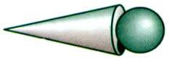
Orthographic views
1st angle system
(Opaque planes)
3rd angle system
(transparent planes/glass box)

Slide 15
Orthographic views
1st angle system
3rd angle system
Folding
line

Folding
line
Folding
line

Folding
line

Slide 16
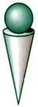
Views arrangement
1st angle system
3rd angle system
Top View
Right Side View
Front View
Front View
Right Side View
Top View

Slide 17
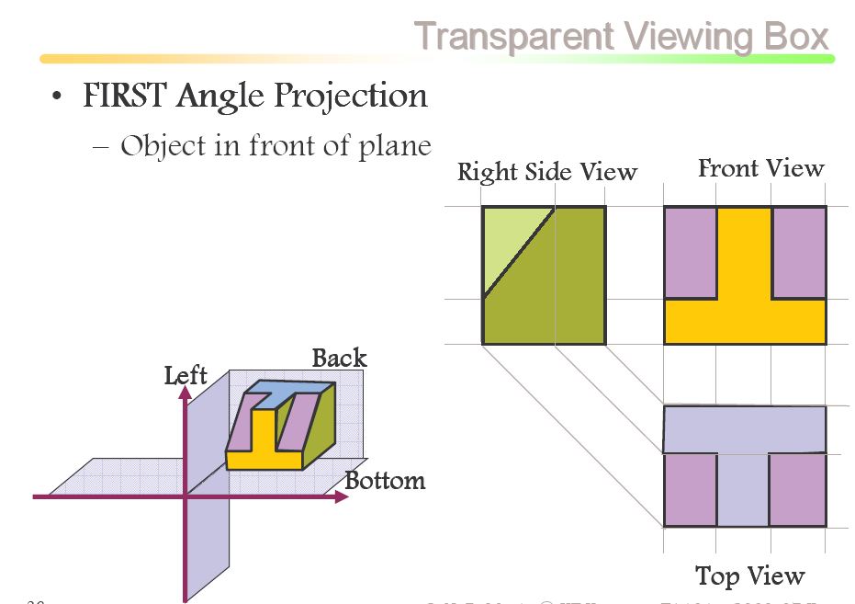
FV

Slide 18
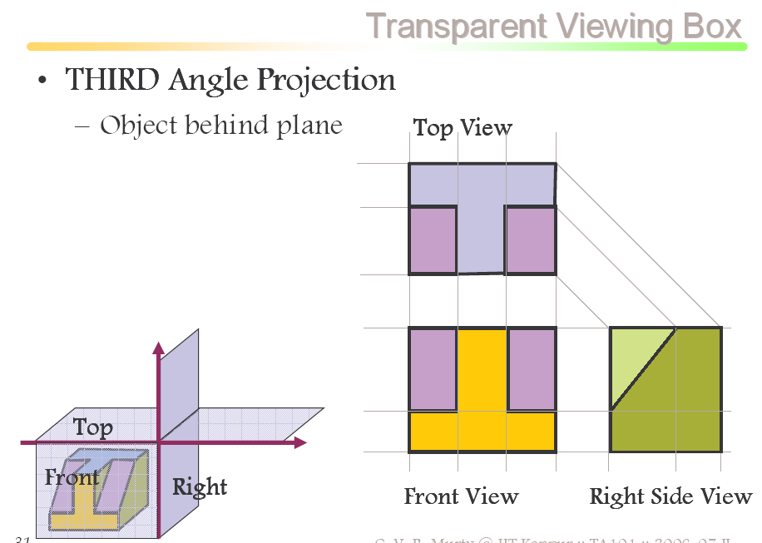

Slide 19
Projection symbols
1st angle system
3rd angle system
d
1.7d
2.2d

Slide 20
PATTERN OF PLANES & VIEWS (First Angle Method)
THIS IS A PICTORIAL SET-UP OF ALL THREE PLANES.
ARROW DIRECTION IS A NORMAL WAY OF OBSERVING THE OBJECT.
BUT IN THIS DIRECTION ONLY VP AND A VIEW ON IT (FV) CAN BE SEEN.
THE OTHER PLANES AND VIEWS ON THOSE CAN NOT BE SEEN.
Y
PROCEDURE TO SOLVE ABOVE PROBLEM:-
TO MAKE THOSE PLANES ALSO VISIBLE FROM THE ARROW DIRECTION,
A) HP IS ROTATED 90⁰ DOUNWARD
B) PP, 90⁰ IN RIGHT SIDE DIRECTION.
THIS WAY BOTH PLANES ARE BROUGHT IN THE SAME PLANE CONTAINING VP.
X
Y
VP
PP
FV
LSV
X
Y
X
TV
HP
ACTUAL PATTERN OF PLANES & VIEWS
OF ORTHOGRAPHIC PROJECTIONS
DRAWN IN
FIRST ANGLE METHOD OF PROJECTIONS
HP IS ROTATED DOWNWARD 90⁰
AND
BROUGHT IN THE PLANE OF VP.
PP IS ROTATED IN RIGHT SIDE 90⁰
AND
BROUGHT IN THE PLANE OF VP.

Slide 21
NOTATIONS
Following notations should be followed while naming
Different views in orthographic projections.
OBJECT POINT A LINE AB
IT’S TOP VIEW a a b
IT’S FRONT VIEW a´ a´ b´
IT’S SIDE VIEW a´´ a´´ b´´
Same system of notations should be followed
incase numbers, like 1, 2, 3 – are used.
TERMS ‘ABOVE’ & ‘BELOW’ WITH RESPECT TO H.P.
AND TERMS ‘INFRONT’ & ‘BEHIND’ WITH RESPECT TO V.P.

Slide 22
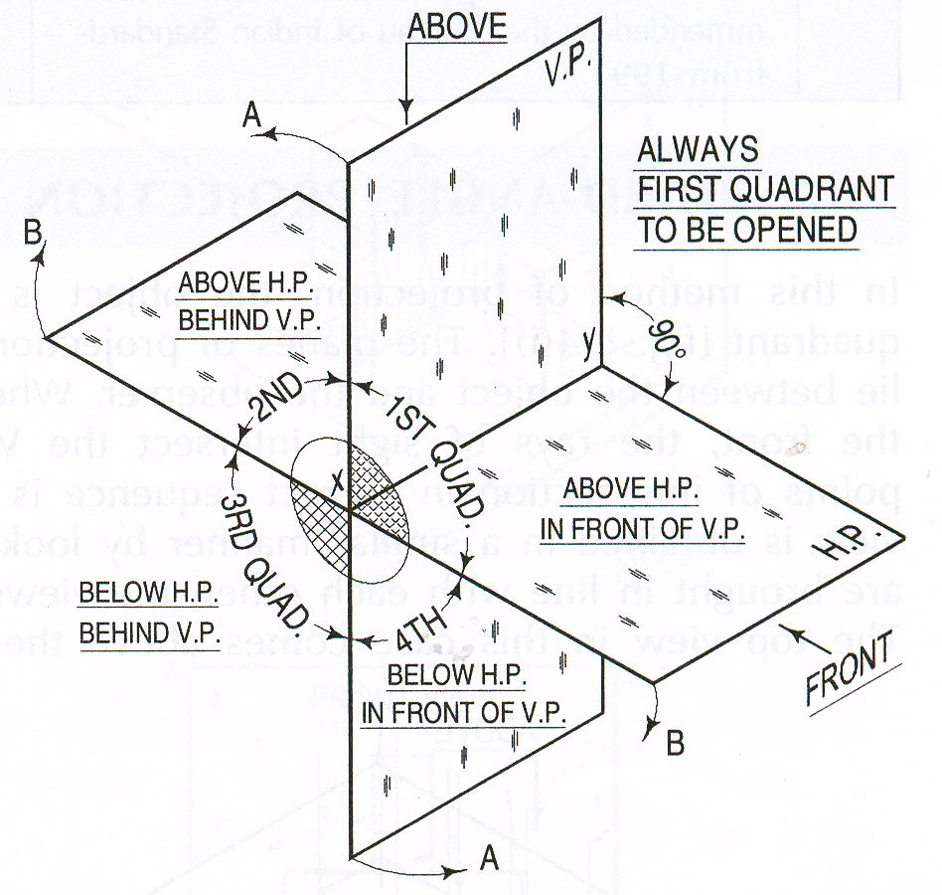

Slide 23
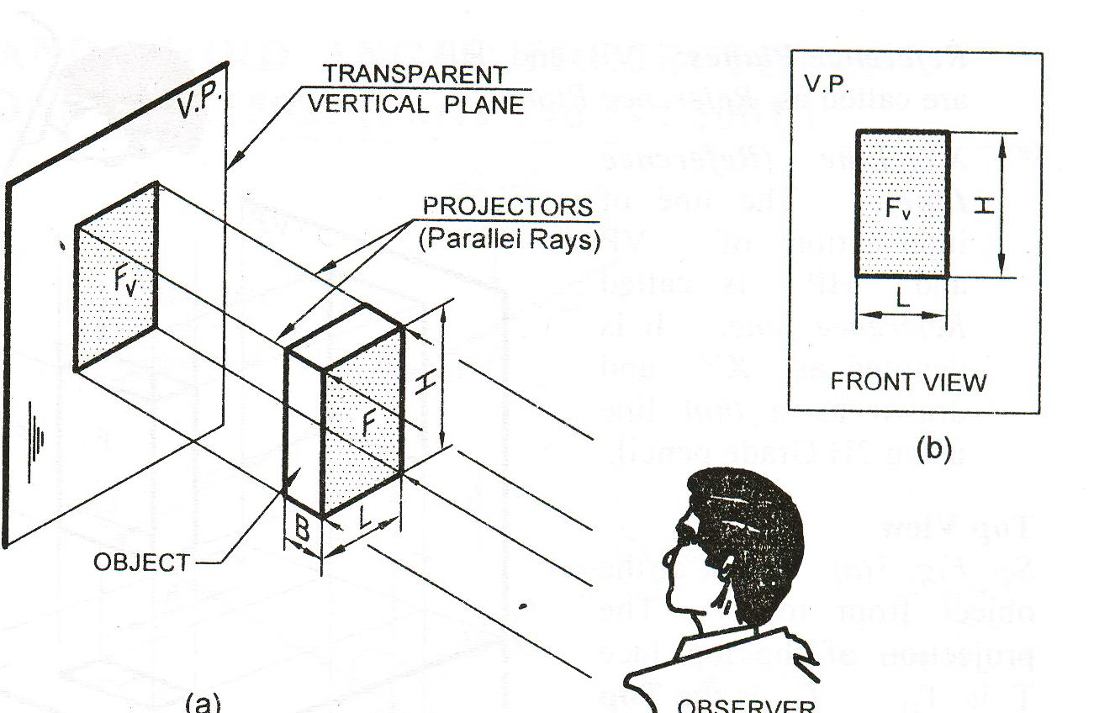
Example 1
Two dimensions are visible.
What is third dimension?
Another view is required.

Slide 24
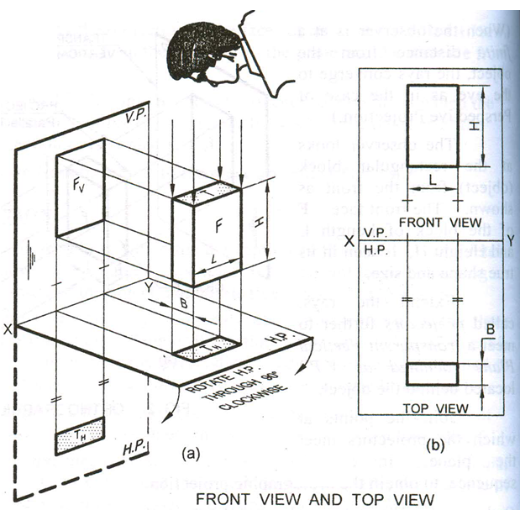

Slide 25
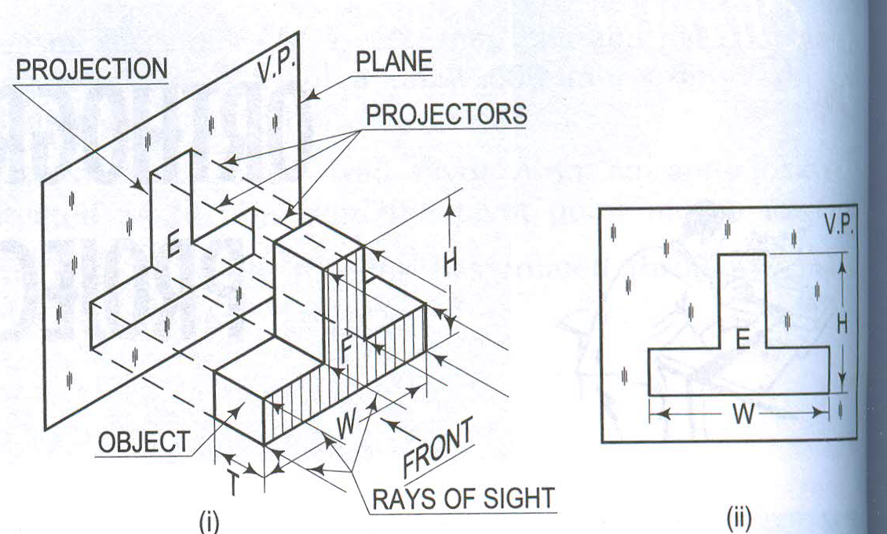
Example 2

Slide 26
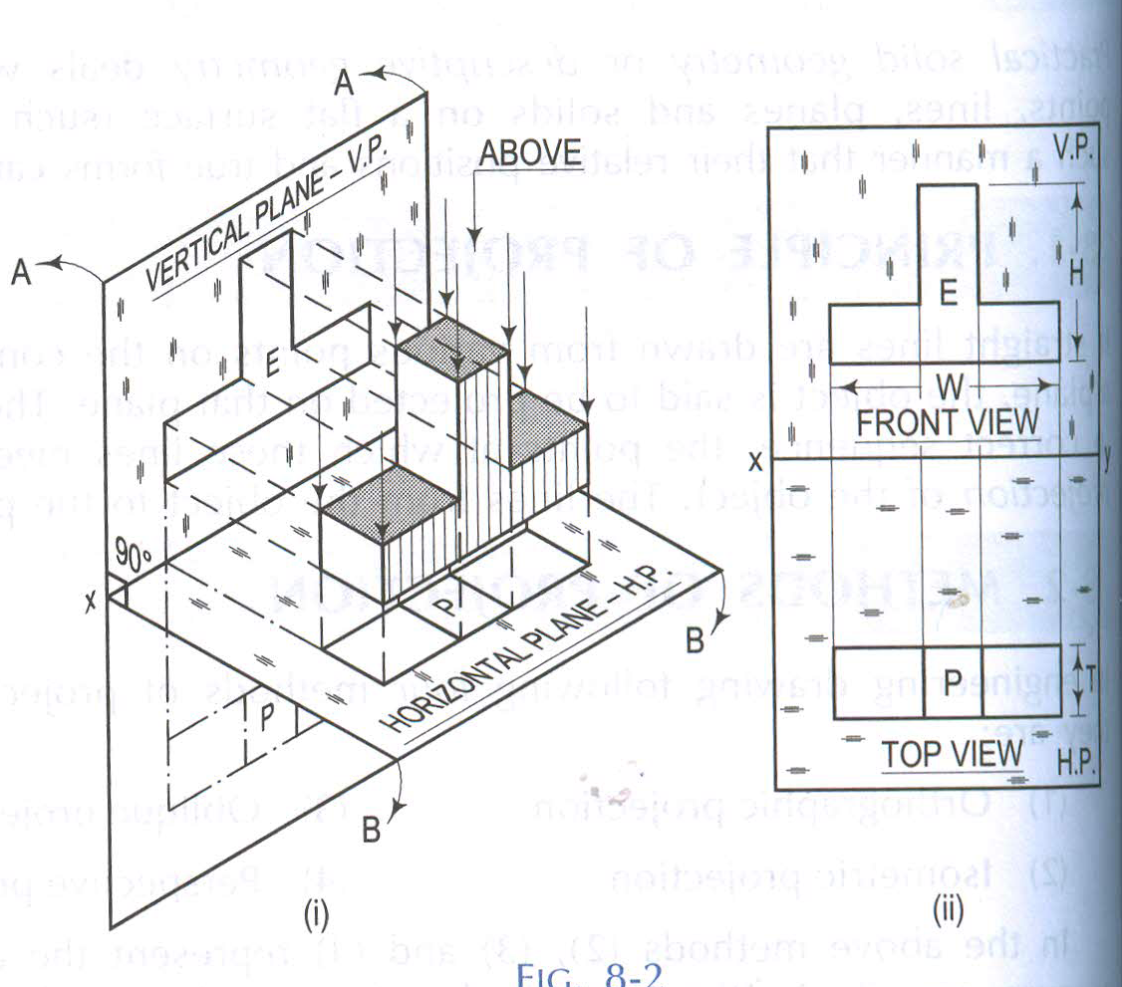

Slide 27
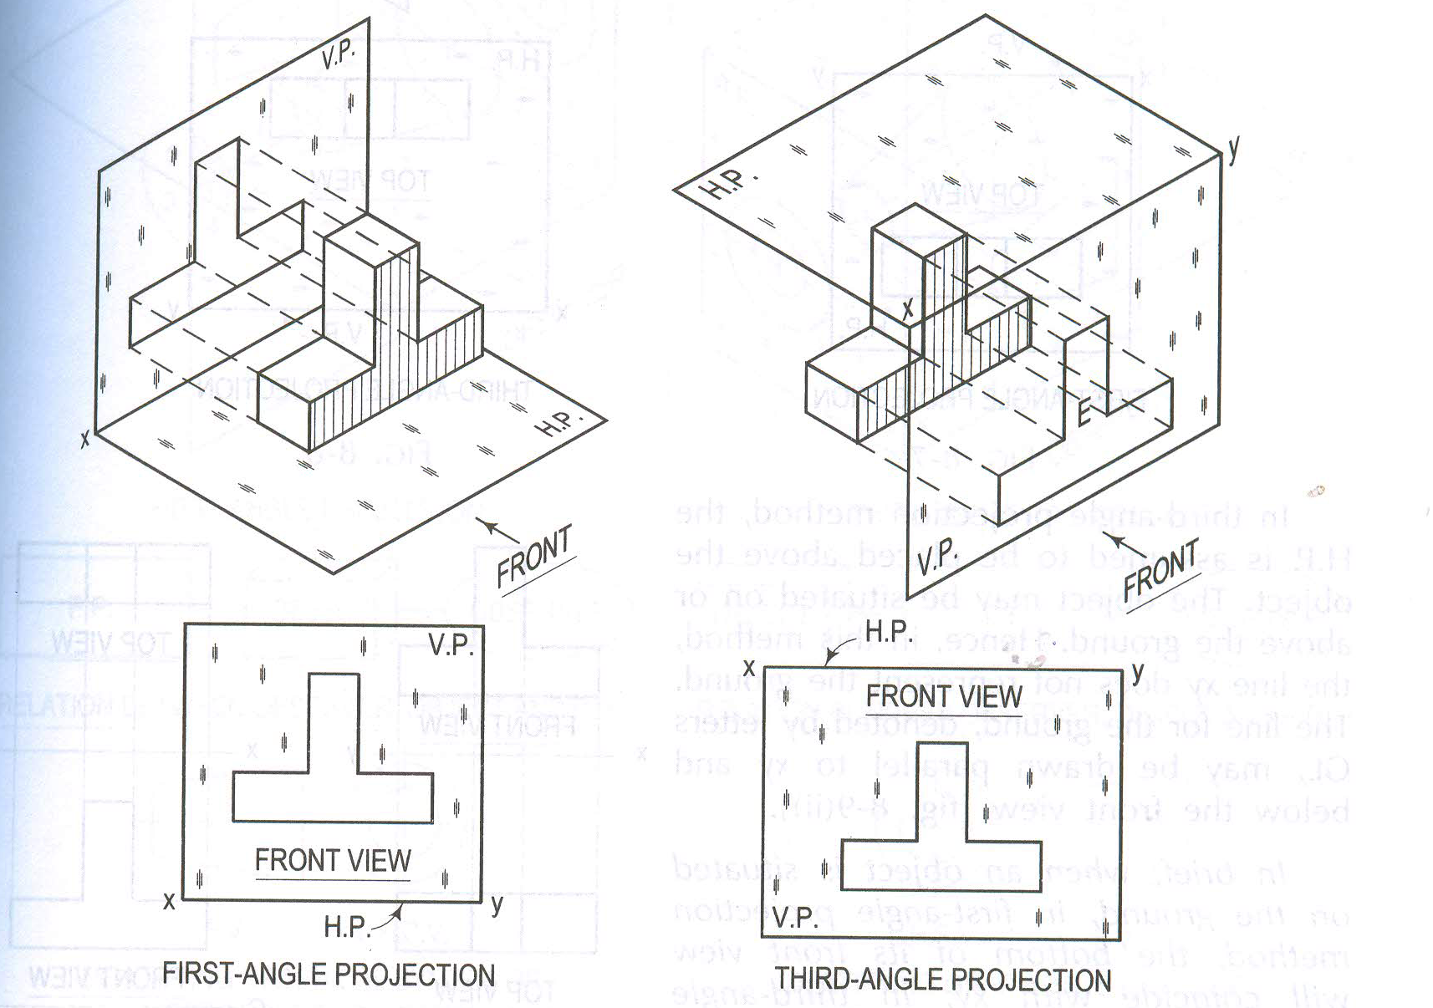
Example 2: Reference Line

Slide 28
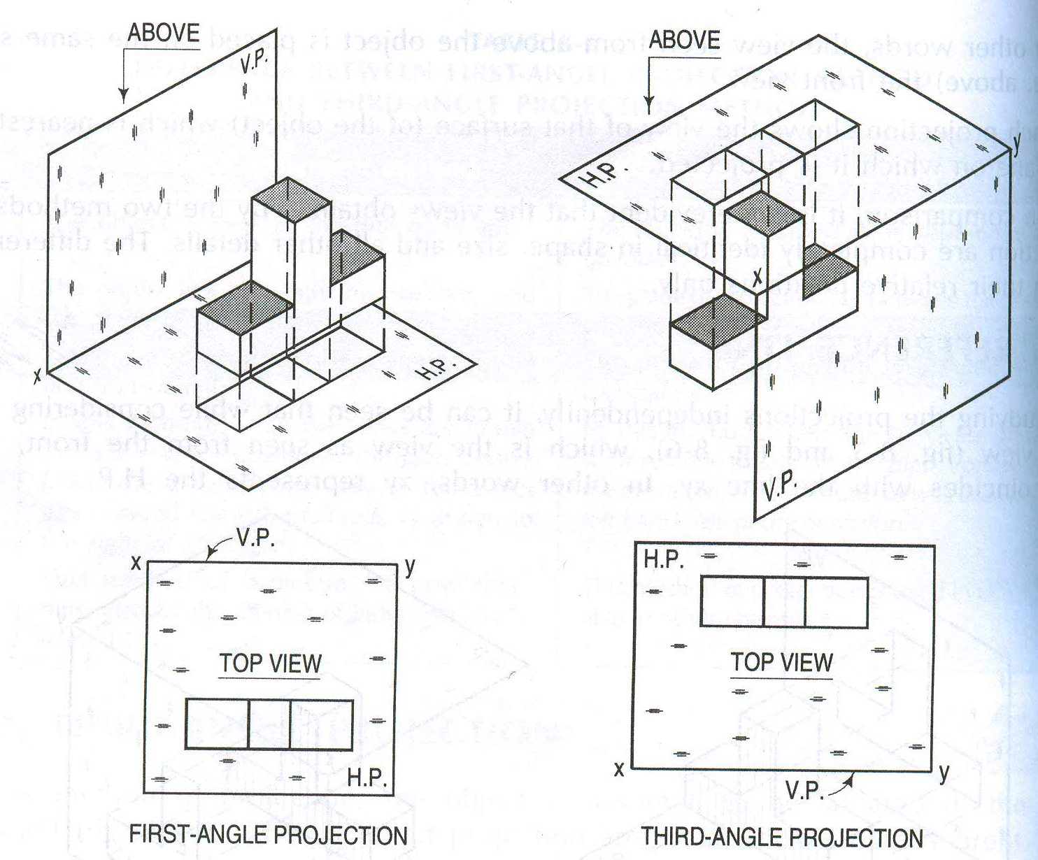
Example 2: Reference Line

Slide 29
To obtain the projections of various faces of an object, the following rules must be observed
If a face is perpendicular to the direction of viewing, its true shape and actual size will be seen in that view.
If a face is parallel to the direction of viewing, it is seen as a line in that view. This view is called the line view or edge view.
If a face is inclined to the direction of viewing, its true shape and size will not be seen in any view.
If an edge of the object is perpendicular to the direction of viewing, its actual length will be seen in that view.
If an edge of the object is parallel to the direction of viewing, it is seen as a point in that view. This view is called point view.
If an edge of the object is inclined to the direction of viewing, its shortened length (projected) will be seen in that view. The shortened length is obtained by locating the end points of the edge.

Slide 30
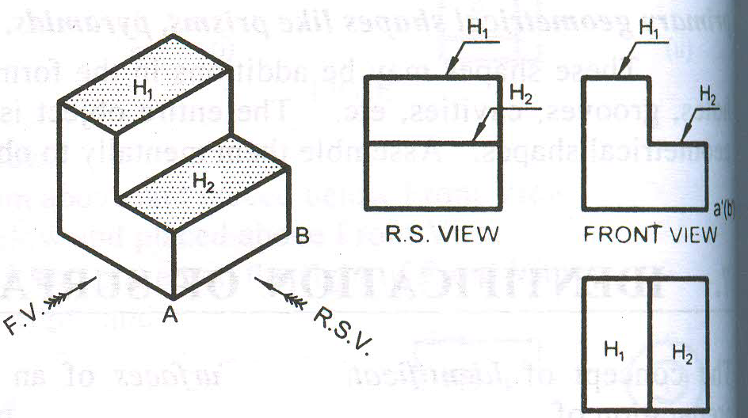
TV
TV
Parallel Surfaces

Slide 31
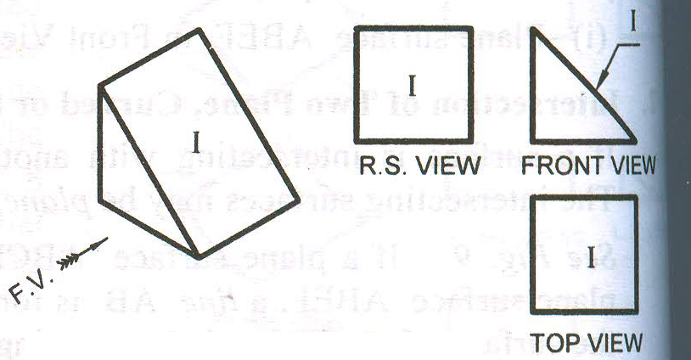
h
w
h
u
w
u
w
Inclined Surfaces

Slide 32
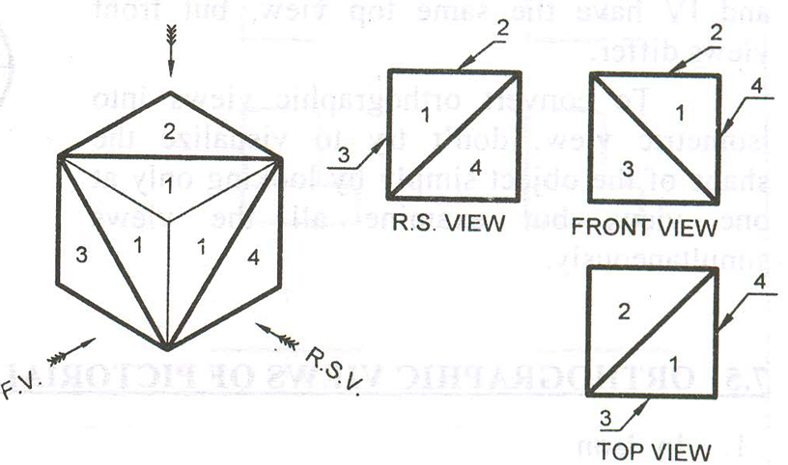
Oblique Surfaces

Slide 33
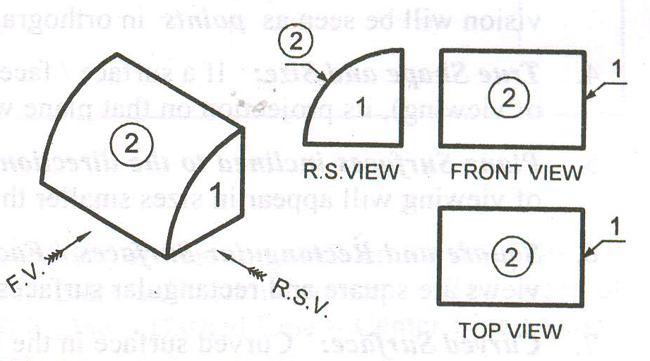
h
u
h
u
w
w
u
Curved Surfaces

Slide 34
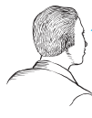
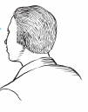
Methods of Orthogonal Projection
1. Natural Method: Revolve the object with respect to observer
2. Glass box method: The observer moves around the object.
Glass box concept
Top view
Top view
Front
view
Right side
view
Front view
Right side view
play
play

Slide 35
Glass box : Revolution of the planes of projection
Rear view
Left side view
Bottom view

Slide 36
Relative orientation of views
Top view
Depth
Front view
Width
Height
Rear view
Left side view
Right side view
Bottom view

Slide 37
Summary : Problem solving steps
Given
1
2
3
4

Slide 38


Steps for Orthographic Views
152
1. Select the necessary views
64
Top
25~40
2. Layout the selected views on a drawing sheet.
45
Front
152
Choose a drawing scale
(say 1:1)
3. Complete each selected views.
x
x
y
z
Top
4. Complete the
dimensions and notes.
y
x
x
Front
y
y

Slide 39

Thank You for Patient Hearing

